Slide 1
WELCOME
To
MY PRESENTATION

Slide 2
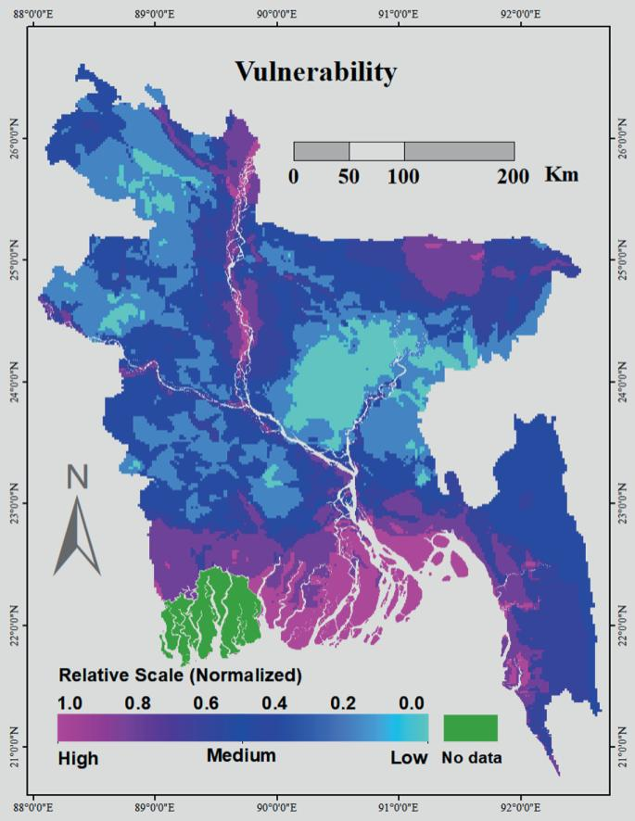
Climate change in Bangladesh
Climate change in Bangladesh" refers to the significant and increasingly severe impacts of global warming on the country, primarily manifested as more frequent and intense floods, cyclones, rising sea levels, erratic rainfall patterns, extreme heatwaves, and coastal erosion, which severely threaten the lives and livelihoods of millions of Bangladeshis due to its low-lying geography and extensive river delta system.

Slide 3
Key points about climate change in Bangladesh:
Extreme Weather Events
Heatwaves
Salinity Intrusion
climate change in Bangladesh
Agricultural Disruptions
Rising Sea Levels
Water Scarcity

Slide 4
Extreme Weather Events in 2019 to 2023 in Bangladesh :
Year | Extreme Weather Event | Frequency | Intensity
2019 | Cyclone & Floods | 3 & 2 | Severe & Moderate to severe
2020 | Heatwaves | 2 | Moderate
2021 | Cyclone & Floods | 1 & 3 | Severe
2022 | Droughts & Floods | 1 & 2 | Moderate
2023 | Heatwaves & Cyclone | 3 & 2 | Moderate & severe

Slide 5
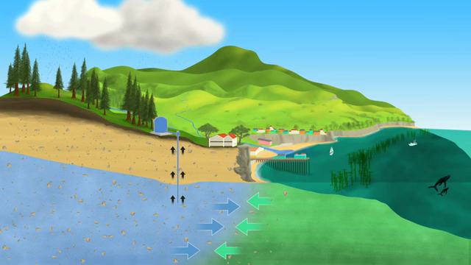
Salinity Intrusion :
Impact on agriculture and freshwater resources.
Health risks and environmental degradation

Slide 6
Flood Frequency And Severity

Slide 7
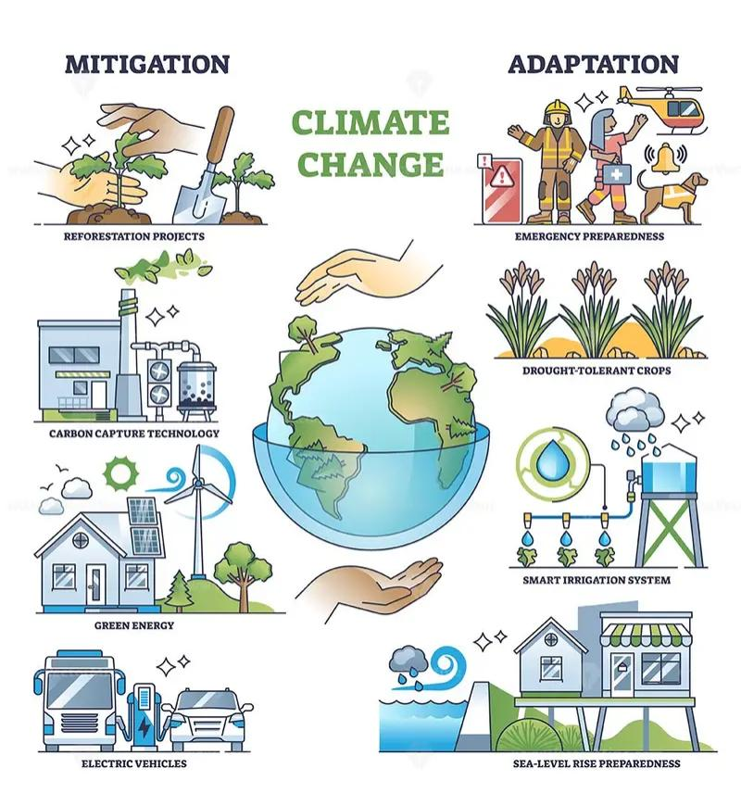
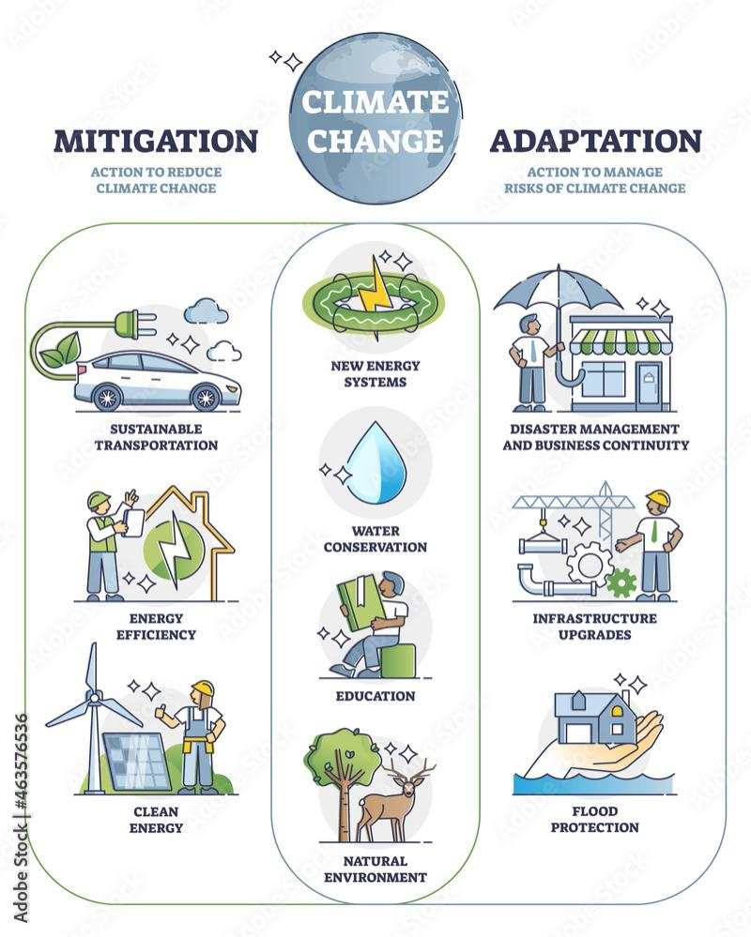
Mitigation and Adaptation Strategies
Mitigation Efforts
Promoting renewable energy sources like solar and wind.
Reducing greenhouse gas emissions through sustainable practices.
Adaptation Measures:
Building flood-resistant infrastructure.
Improving water management and irrigation systems.
Enhancing disaster preparedness and early warning systems.

Slide 8
Conclusion and Call to Action
Urgency:
Climate change is already affecting Bangladesh, and the situation will worsen without action.
International Cooperation:
Bangladesh needs global support for adaptation and climate finance.
Call to Action:
Government action on climate policies.
Raising public awareness about the importance of sustainable practices.
Engaging the youth and local communities in climate action.

Slide 9
THANK YOU FOR WATCHING MY PRESANTATION

